Slide 1
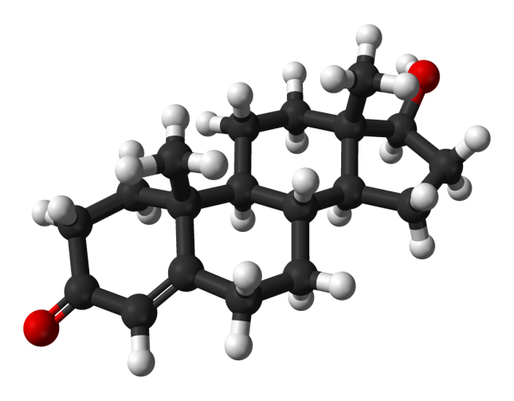
Low Testosterone & Its Treatment
FOR MEN

Slide 2
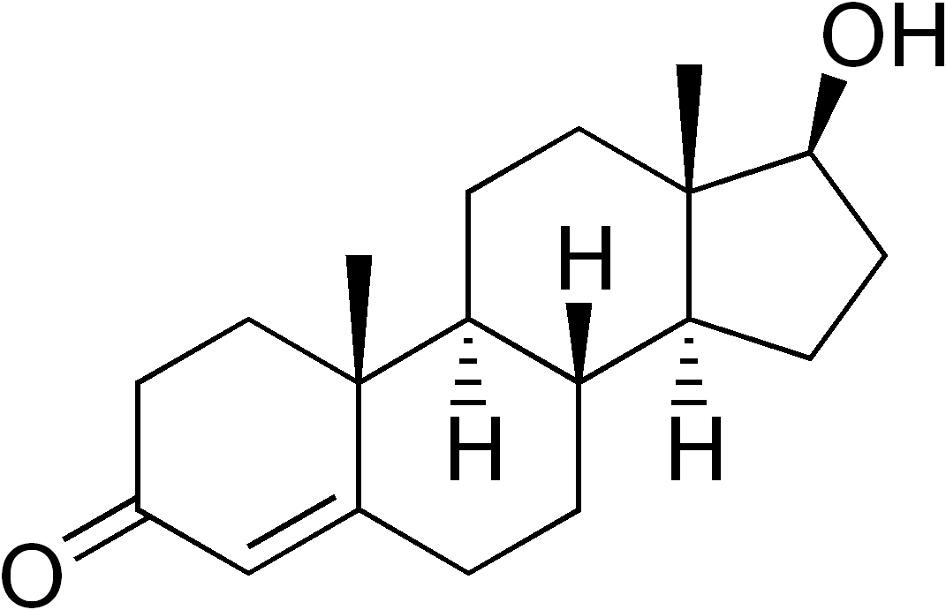
Testosterone

Slide 3
What is Testosterone?
Steroid hormone from the androgen group
Stimulates development of male secondary sexual characteristics, produced mainly in the testes, but also in the ovaries and adrenal cortex.
- Wikipedia

Slide 4
Health effects
Anabolic effects:
Muscle mass and strength
Increased bone density and strength
Stimulation of linear growth
Bone maturation. etc.
Androgenic effects:
Maturation of the sex organs
Deepening of the voice, etc

Slide 5
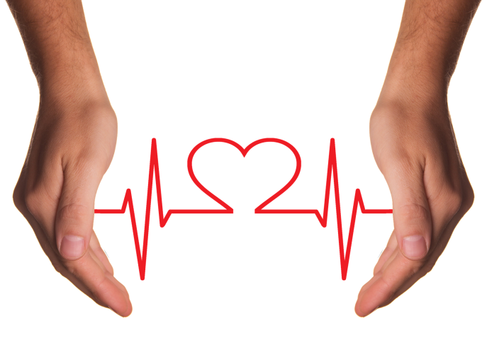
Benefits of Testosterone
1. Healthy Heart and Blood
A healthy heart pumps blood to the rest of the body, providing muscles and organs with the oxygen needed for peak performance.

Slide 6
Benefits of Testosterone
2. Less Fat, More Muscle
Leaner body mass helps control weight and increases energy.

Slide 7
Benefits of Testosterone
3. Stronger Bones
Strong bones help support your muscles and internal organs, which can boost athletic performance.

Slide 8
Benefits of Testosterone
4. Better Libido
Testosterone levels naturally rise in response to sexual arousal and activity.

Slide 9
Medical uses
The primary use of testosterone is the treatment of males with too little or no natural testosterone production—males with hypogonadism.
Known as hormone replacement therapy or testosterone replacement therapy (TRT).

Slide 10
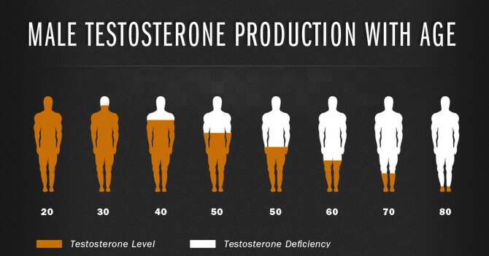
Low levels due to aging
Testosterone levels decline gradually with age…

Slide 11
Insufficiency
Testosterone insufficiency (also termed hypotestosteronism or hypotestosteronemia) is an abnormally low testosterone production.
It may occur because of :
Testicular dysfunction (primary hypogonadism)
Or
Hypothalamic-pituitary dysfunction (secondary hypogonadism)

Slide 12
Symptoms of Low T

Slide 13
Warning Signs or Symptoms of Low Testosterone
Muscle Tissue (Loss)
Brain Function (Decreased)
Heart (Weakened)
Fat (Increase)
Drowsiness
Moodiness
Diminished Libido

Slide 14
Normal levels of testosterone in men

Slide 15
Testosterone Levels

Slide 16
Symptoms of Hypogonadism
Male hypogonadism can occur at any age, as a result of problems affecting the testicles or the pituitary gland.

Slide 17
Signs of hypogonadism in infants include:
Ambiguous genitalia
Female genitalia (in a genetically male child)
Underdeveloped male genitalia

Slide 18
In boys, symptoms of hypogonadism include:
Lack of development of muscle mass
No deepening of the voice or growth of body hair
Slow increase in size of penis or testicles
Arms and legs that grow out of proportion to the rest of the body

Slide 19
In adult men, symptoms of hypogonadism include:
Lack of fertility
Low sex drive
Erectile dysfunction
Sparse facial or body hair
Growth of breast tissue

Slide 20
Symptoms of Age-Related Testosterone Decline
Fatigue
Weakness
Depression
Sleep disturbances

Slide 21
Low Testosterone Levels
Low testosterone levels, or "low T," can be caused by a wide variety of medical conditions or by the use of some drugs.
After age 30, most men experience a gradual drop in testosterone.

Slide 22
Causes of Low Testosterone
Autoimmune diseases
Chronic liver or kidney disease
Chronic obstructive lung disease
Genetic causes
Heart failure
HIV/AIDS

Slide 23
Causes of Low Testosterone
Infections (such as mumps)
Injury to the testicles
Metabolic disorders
Obesity

Slide 24
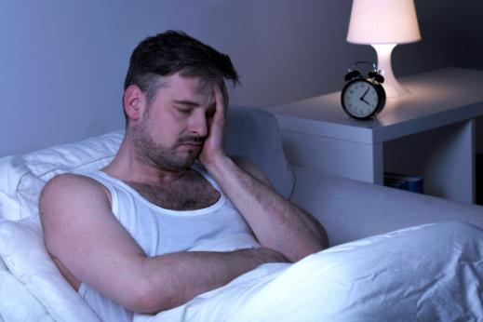
Causes of Low Testosterone
Prolactinoma (prolactin-secreting tumor) in the pituitary gland
Testicular cancer or treatment for testicular cancer
Type 2 diabetes

Slide 25
Drugs associated with low testosterone levels
Alcohol
Chemotherapy drugs used to treat cancer
Corticosteroids (sometimes called glucocorticoids)
Opioids

Slide 26
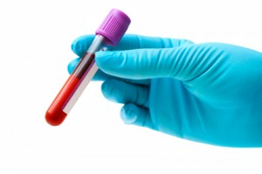
Low T Diagnosis
Hypogonadism and age-related low testosterone are diagnosed with blood tests that measure the level of testosterone in the body.

Slide 27
Low T Diagnosis
Testosterone levels can vary from day to day, and by time of day, so at least two blood tests are needed to confirm a hypogonadism diagnosis.
The first blood test will give your doctor a baseline. The second test confirms your levels and helps confirm a diagnosis.

Slide 28
Low T Diagnosis
There are two types of blood tests that can be done to measure your testosterone. The most common test measures the total testosterone in your body.
Your doctor may also order a free testosterone test as well as additional tests to help confirm a diagnosis.

Slide 29
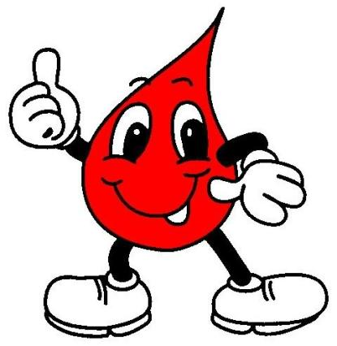
Low T Diagnosis
Since testosterone levels are at their peak in the morning, it's recommended that blood tests are performed in the morning.

Slide 30
Is Low Testosterone Dangerous to Your Health?
A lack of testosterone can sometimes have long-term, serious effects on the body.
In men with very low levels, the bones can become weak, potentially causing a condition called osteoporosis.
Osteoporosis makes people considerably more prone to injury.
One study in the Journal of Clinical Endocrinology and Metabolism also linked low testosterone to a higher risk of death from heart disease and other causes.

Slide 31
Treatment of Low Testosterone
The best treatment for "low T" depends on its cause. Sometimes testosterone replacement therapy is needed; other times, weight loss is the best medicine.

Slide 32
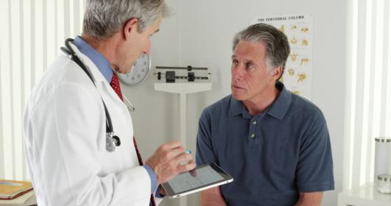
Low T Treatment Options
Skin Gel
Patches
Shots
Tablets
Testosterone injections

Slide 33
Considering Testosterone Replacement Therapy?
Testosterone replacement therapy can be beneficial for men with low testosterone levels.
Doctors and researchers have varying opinions regarding effectiveness.
.

Slide 34
Considering Testosterone Replacement Therapy?
The experts at the Mayo Clinic say that study results are mixed. For maximum effectiveness, maintain a healthy diet and exercise regularly. Don’t purchase testosterone without a prescription. Follow-up care and monitoring is recommended.

Slide 35
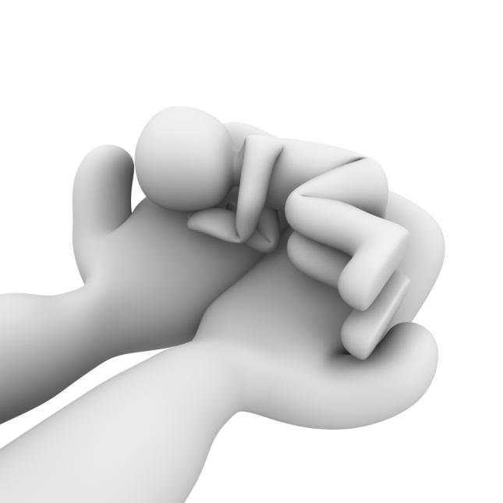
How to Boost Testosterone Naturally
Get a Good Night’s Sleep
Lose That Excess Weight
Go Easy on the Sugar (Less Sugar)
Maintain a healthful diet
Get regular exercise
Limit alcohol

Slide 36
Bottom Line
Patients with severe heart disease, liver disease or kidney disease should not use any kind of testosterone replacement therapy except under close medical supervision.
Thank You…

